Slide 1
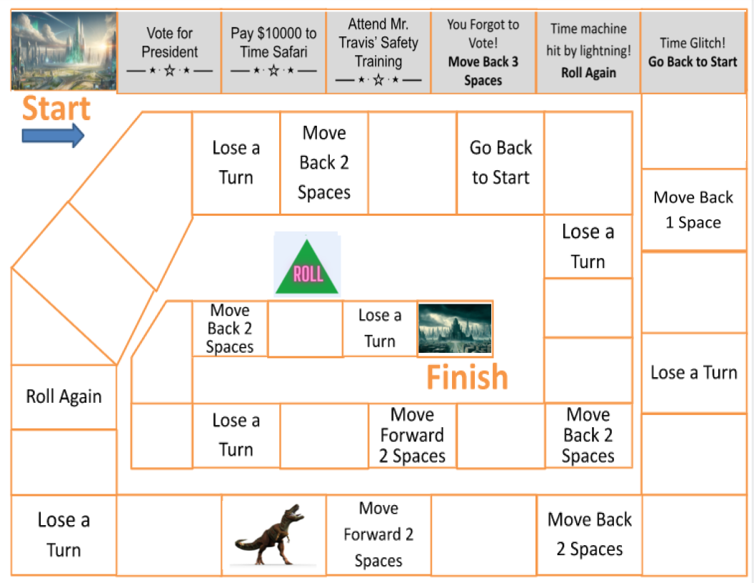

Insert text
Insert text
Insert text
Insert text
Insert text
Insert text
Insert text
Insert text
Insert text
Insert text
Insert text
Insert text
Insert text
Insert text
Insert text
Insert text
Insert text
Insert text
Insert text
Insert text
Insert text
Insert text
Insert text
Insert text
Insert text
Insert text
Insert text
Insert text
Insert text
Insert text
Insert text
Insert text
Insert text
Insert text

